Slide 1

RAPID APPLICATION DEVELOPMENT
RAD

Slide 2
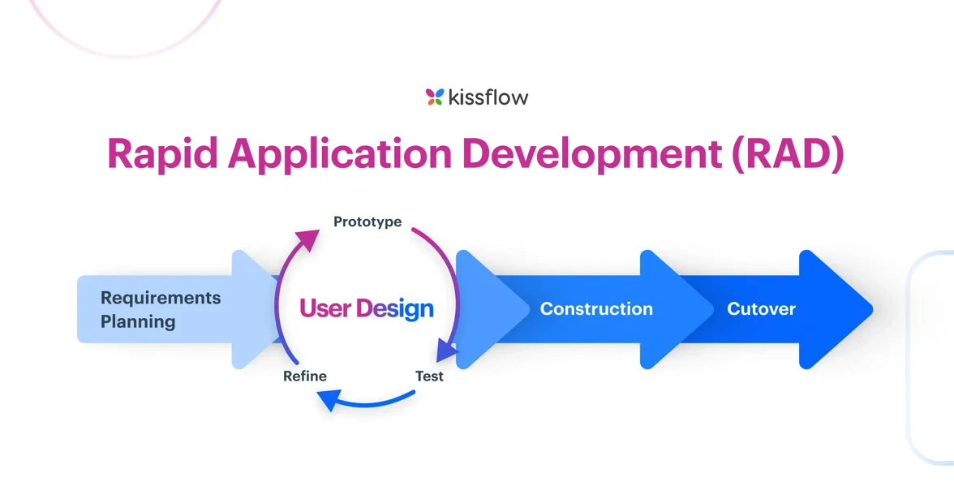
Introduction and Overview
A software development process based on prototyping and quick feedback with less emphasis on specific planning. This leads to more quality-focused products that meet the end users’ requirements.
The RAD model was introduced in the 1980s by James Martin as a response to the traditional Waterfall model, which was often slow and rigid.
Learn More

Slide 3
Objectives
Speedy Development by focusing on rapid prototyping and iterations to deliver a working system quickly.
01
Adaptability & Flexibility - Allows easy modifications based on changing requirements.
02
Better Quality through Prototyping - Early testing and visualization help identify issues sooner. It also ensures design validation and a user-centered final product.
03
Speedy Development by focusing on rapid prototyping and iterations to deliver a working system quickly.
04
05
Stakeholder Participation - Encourages active involvement of end users and stakeholders through feedback

Slide 4
Phases of RAD
03
Requirements Planning Phase
Combines system planning and analysis from the SDLC
Defines critical data and methods for processing into a refined model.
Construction Phase
Refines the prototype into a final working product.
Uses automated tools to transform processes and data models and incorporates required modifications and enhancements.
01
03
User Design/Prototype Phase
Gathers user feedback and builds a prototype using development tools.
Re-examines and validates data from the first phase.
Cutover Phase.
Includes data conversion, system testing, changeover to the new system, and user training before deploying
02
03

Slide 5
Advantages
Disadvantages
Risk control - Incremental development minimizes the risk of major project failures. Each iteration is easily tested as it is a small manageable unit, before full deployment.
Lack of emphasis on non functional requirements, which are often not visible to the end user in normal operation.
01
01
More projects completed on time and within budget - Early error detection reduces debugging costs. Faster product launch means quicker revenue generation.
Reduced features due to time boxing, where features are pushed to a later version to finish a release in short period
02
02
The software can be more usable and has a better chance to focus on business problems that are critical to end users rather than technical problems of interest to developers
Reduced scalability occurs because a RAD developed application begins as a prototype and evolves into a finished application
03
03
Better Quality - User feedback throughout ensures the final product meets end user expectations.
Heavy need for userinvolvment as continuous feedback requires users to be highly available. A lack of leads to project failure
04
04
05
Poor Documentation as the focus on rapid development often leads to inadequate documentation making maintenance and upgrades harder.
05
The use of reusable components helps to reduce the cycle time of the project.

Slide 6
Best Applications of RAD
Small to Medium-Sized Projects
Works well when project complexity is moderate.
- Example: Customer Relationship Management (CRM) systems.
UI/UX-Centric Applications
Suitable for applications where user experience is critical.
Example: Mobile apps, web-based applications.
01
03
Prototyping-Based Development
Useful when stakeholders need a working model before finalizing requirements.
Example: E-commerce platforms with frequently changing features.
05
Applications with Unclear Requirements
Ideal when requirements are expected to evolve.
Example: Startups developing MVPs (Minimum Viable Products).
Time-Sensitive Projects
When there is a strict deadline, RAD ensures faster delivery.
- Example: Internal business applications that need quick deployment.
02
04
01

Slide 7
Conclusion
RAD is an effective development methodology for projects that require speed, user involvement, and flexibility. However, it is not ideal for large-scale, security-critical applications that demand extensive documentation and rigorous testing. Organizations must assess their project requirements, team expertise, and user availability before adopting RAD.

